Slide 1
Intro to Rocketry

Slide 2
What is a rocket?
According to NASA, a rocket is “A vehicle, typically cylindrical, containing liquid or solid propellants which produce hot gases or ions that are ejected rearward through a nozzle.”
Notes:
Have the kids answer the question first

Slide 3
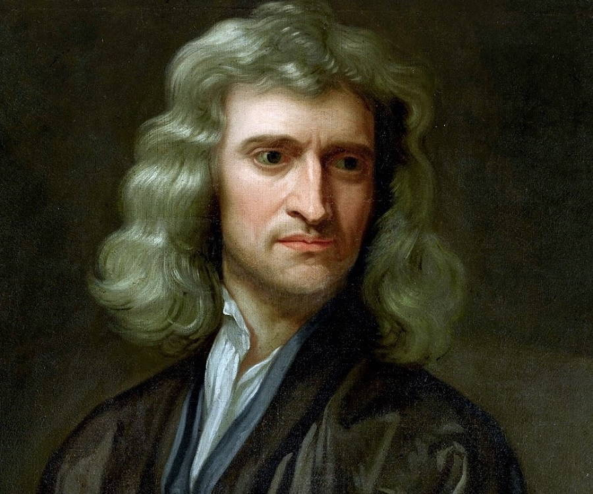
Newton’s Laws of Motion
An object at rest or at constant velocity will remains so until acted upon by an external force. (Law of inertia)
The net force on an object equals the force applied times its acceleration. (F = ma)
For every action, there is an equal and opposite reaction.
Notes:
How do these three laws relate to rocketry?

Slide 4
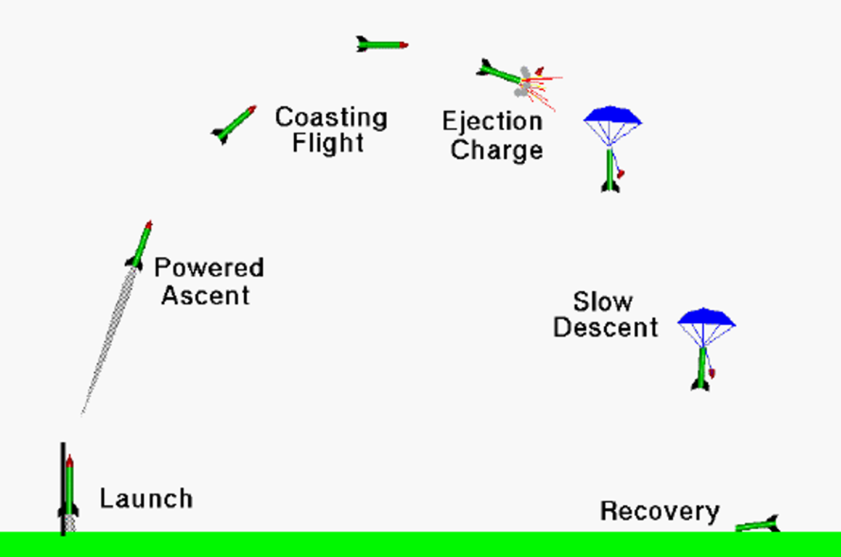
Flight of a Model Rocket
Notes:
Talk about velocity and acceleration at each point

Slide 5
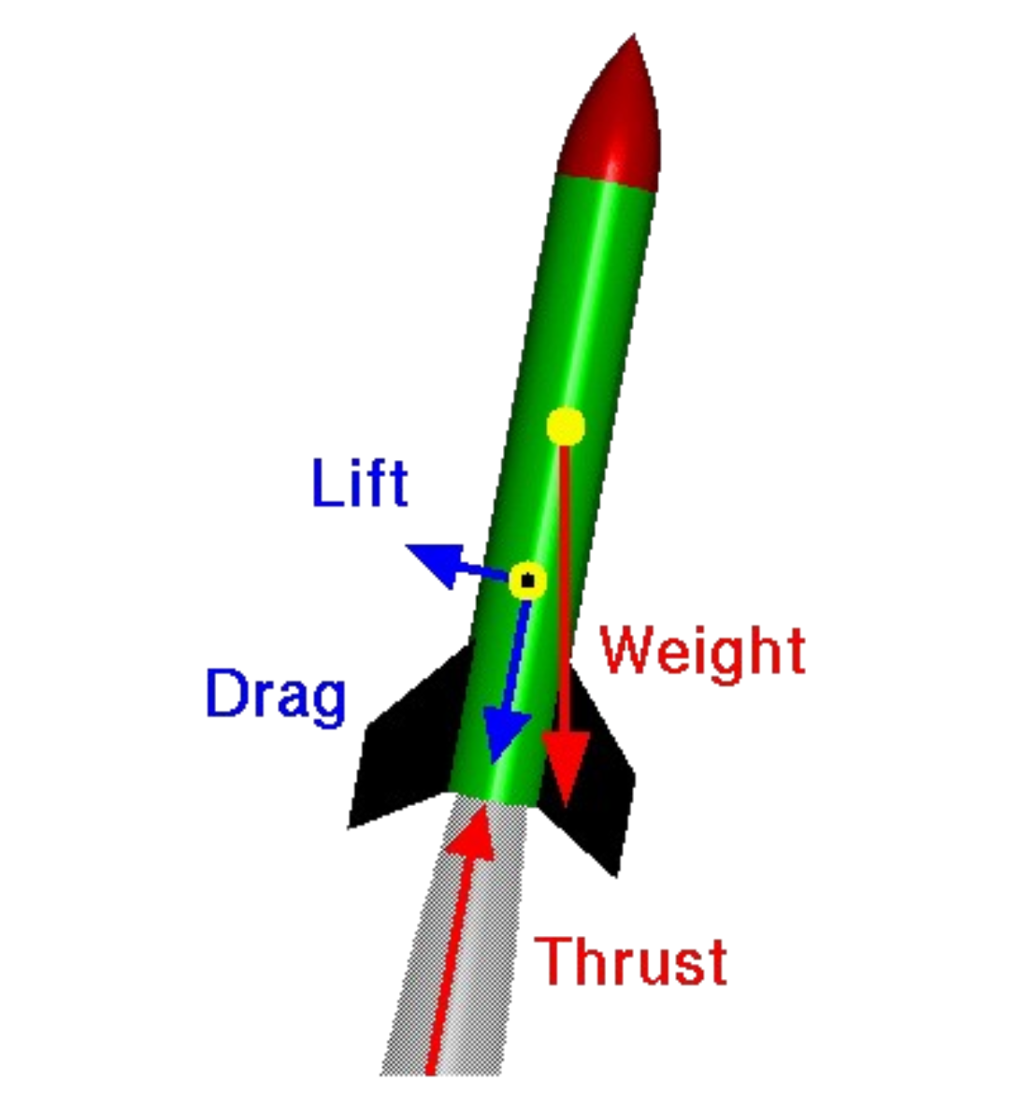
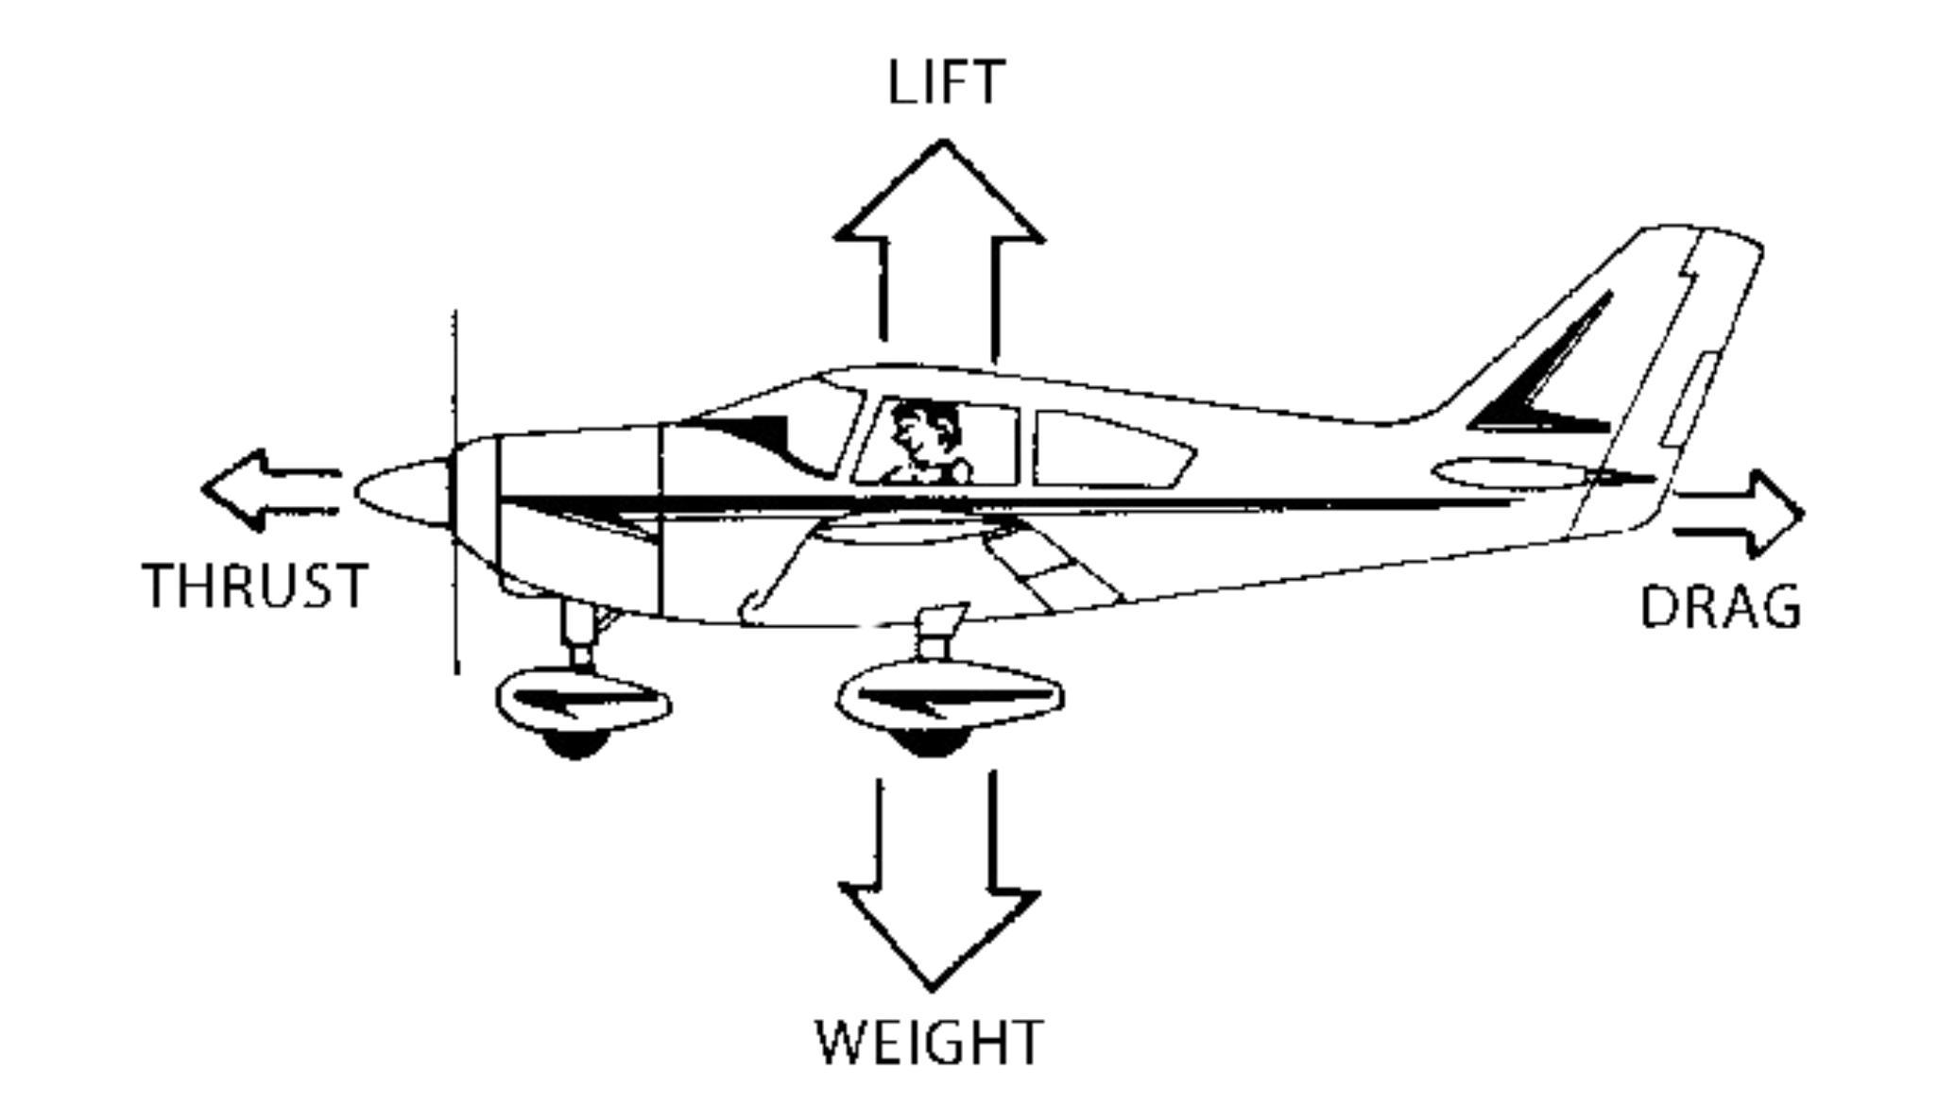
Forces on a Rocket and Airplane
Notes:
Drag – depends on surface area
Lift – less relevant on rockets, but is due to fins – caused by angle of attack

Slide 6
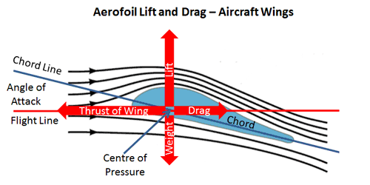
Lift Force
Notes:
Drag – depends on surface area
Lift – less relevant on rockets, but is due to fins – caused by angle of attack

Slide 7
01
ASTRONOMICAL OBSERVATORY
You could enter a subtitle here if you need it

Slide 8
Aerodynamics of Flight
The Object:
Shape
Size
The Motion:
Velocity
Angle to airflow
The Air:
Viscosity
Density
Compressibility

Slide 9
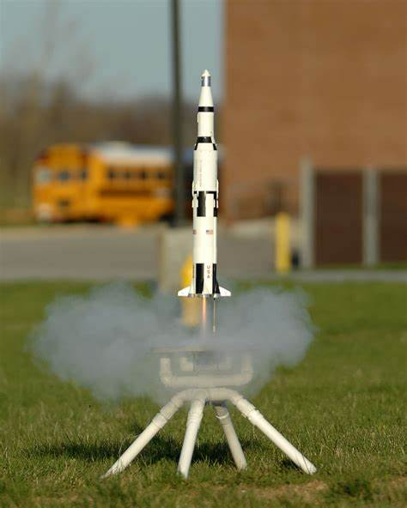
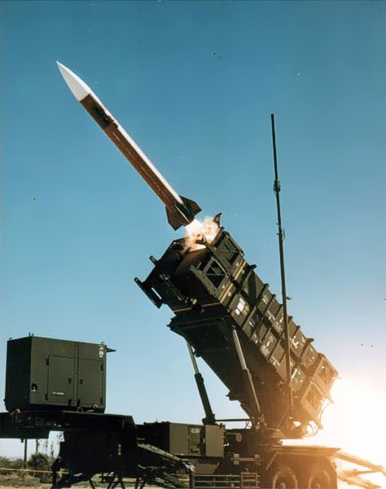
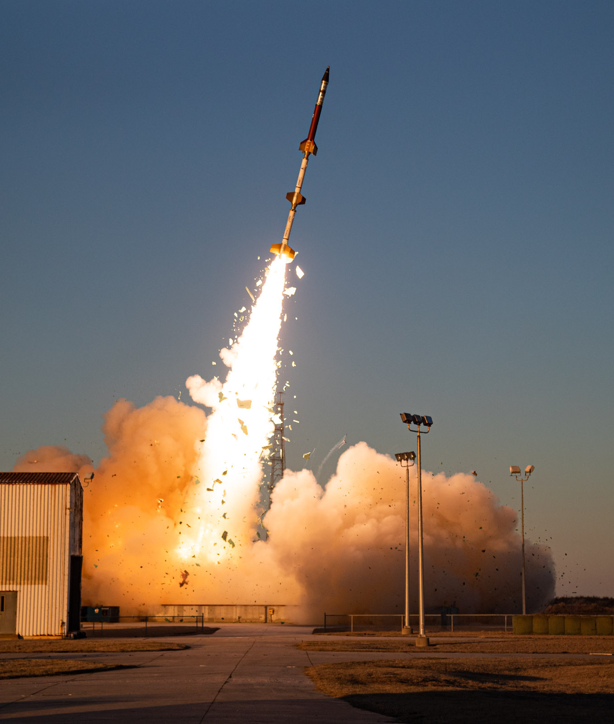
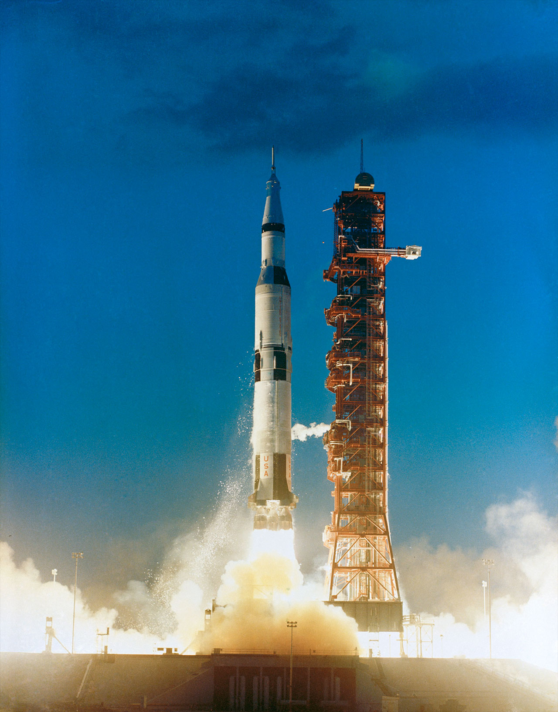
Uses of Rocketry
Hobby
Missles
Sounding Rockets
Launch Vehicles
Notes:
Sounding rockets – Rockets carrying scientific instruments into the upper atmosphere to take measurements of things like air quality and radiation in the air

Slide 10
OBSERVE EARTH SATELLITES
VENUS
MERCURY
Venus is the second planet from the Sun
Mercury is the closest planet to the Sun
MARS
JUPITER
Despite being red, Mars is a cold place
Jupiter is the biggest planet in the Solar System

Slide 11
STUDY CELESTIAL SOURCES
MERCURY
JUPITER
Mercury is the closest planet to the Sun
Jupiter is the biggest planet of them all
VENUS
SATURN
Venus is the second planet from the Sun
Saturn is composed mostly of hydrogen and helium
NEPTUNE
MARS
Neptune is the farthest planet from the Sun
Despite being red, Mars is actually a cold place

Slide 12
AWESOME WORDS

